Slide 1
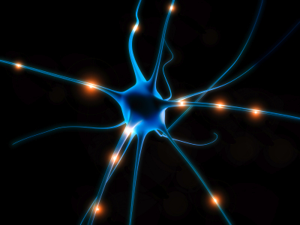
Amyotrophic Lateral Sclerosis and SOD1
Anne Sapiro
Notes:
http://blog.biocision.com

Slide 2
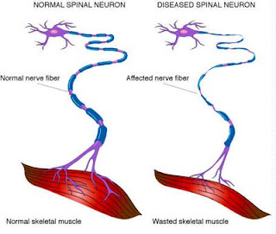
Amyotrophic lateral sclerosis facts
Neurodegenerative disease
Loss of motor control
Fatal within 3-5 years
90% sporadic
20% of familial ALS caused by mutations in SOD1
www.thehealthsuccesssite.com

Slide 3
Superoxide Dismutase 1 (SOD1)
Furukawa Y , O'Halloran T V J. Biol. Chem. 2005;280:17266-17274
Notes:
Copper Zinc superoxide dismutase domain: binds copper and zinc, forms a homodimer and turns reactive oxygen species into hydrogen peroxide.

Slide 4
ALS-causing mutations in SOD1
1 5
150 154aa
Human SOD1
SOD Cu
5
154
83 amino acids with missense or nonsense mutations
http://alsod.iop.kcl.ac.uk

Slide 5
SOD1 protein domains across homologs
1 5
150 154aa
Human SOD1
SOD Cu
1 5
150 154aa
Mouse SOD1
SOD Cu
1 5
150 154aa
Zebrafish SOD1
SOD Cu
Notes:
Mouse 80% identical to humans; zebrafish is 73%. Many of the human mutations cause ALS-like phenotypes in model organisms.

Slide 6
Mutant SOD1: Toxic GOF
Furukawa Y , O'Halloran T V J. Biol. Chem. 2005;280:17266-17274
Notes:
How do these mutations confer toxicity?

Slide 7
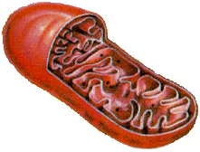
Gene Ontology: Biological Processes
Apoptosis
SOD1
Mitochondrial Respiration
Notes:
Choosing to focus on mitochondrial driven processes from gene ontology.

Slide 8
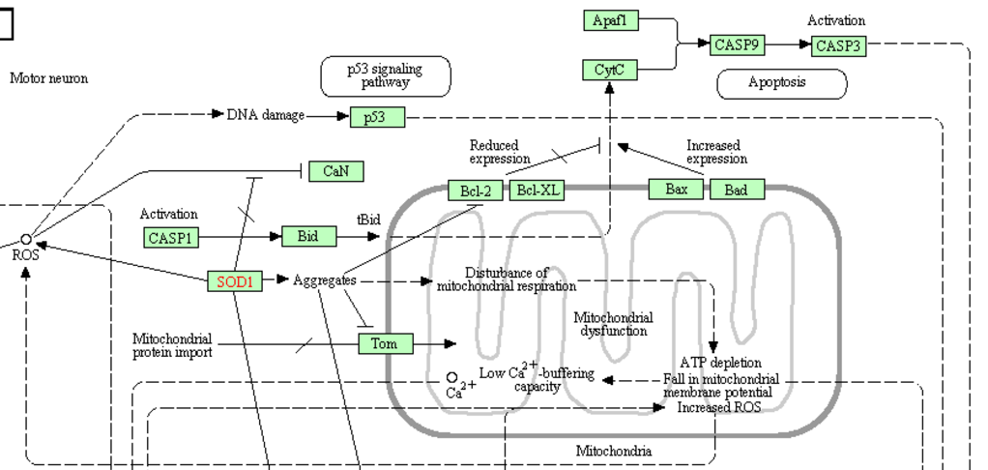
SOD1 aggregates lead to mitochondrial defects
What comprises aggregates?
Notes:
SOD1 leads to aggregates which seem to be a causative agent of disturbance of mitochondrial respiration and apoptosis among other things.

Slide 9
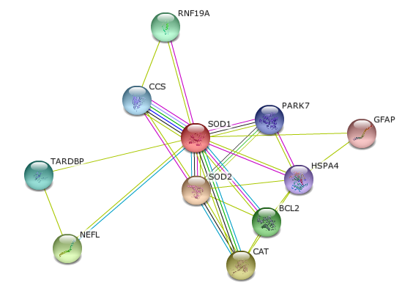
Human SOD1 Interaction Network
Notes:
Park7 mutations lead to Parkinson’s disease. What are the similarities between these neurodegenerative diseases?

Slide 10
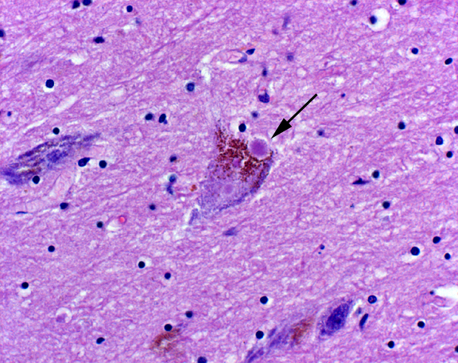
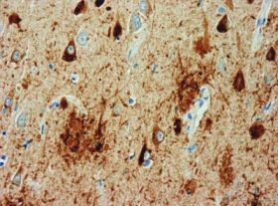
Aggregates and neurodegeneration
Parkinson’s Lewy bodies
Huntington’s inclusions
http://neuropathology-web.org/
Alzheimer’s plaques
http://missinglink.ucsf.edu/lm/ids_104_neurodegenerative/Case2/Case2Micro.htm
http://cdn.physorg.com
Notes:
Aggregates are common occurrences in many neurodegenerative diseases.

Slide 11
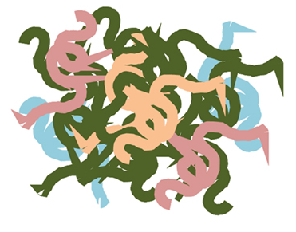
Parkinson’s Lewy bodies
α-synuclein
Neurofilaments
Ubiquitin
Adapted from Branco et al. 2010
Notes:
Alpha-synuclein: protein of unknown function in neurons that makes up a lot of Lewy bodies
Ubiquitin: targets proteins for degradation among other things
Neurofilaments: part of cytoskeleton in neurons

Slide 12
Hypothesis: ALS aggregates contain components of Parkinson’s Lewy bodies.
Approach:
Look at interaction networks in humans and homologs

Slide 13
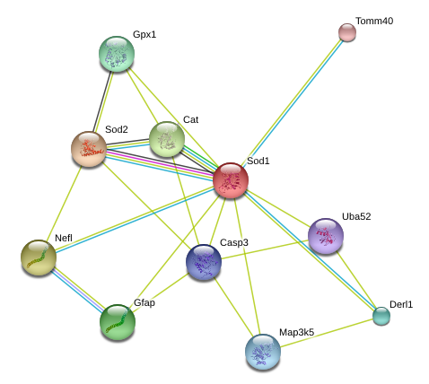
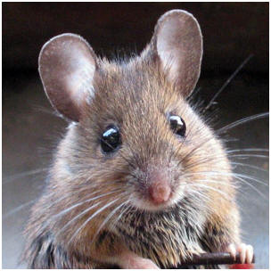
Ubiquitin-related proteins in SOD1 interaction networks
Uba52
RNF19A
E3 Ubiquitin-protein ligase
Notes:
E3 ligase puts Ubquitin onto proteins. Uba52 has UBQ domain along with a ribosomal domain.

Slide 14
Neurofilaments in SOD1 interaction networks

Slide 15
Question: What else is in ALS aggregates?
Approach:
Proteomics in model organism

Slide 16
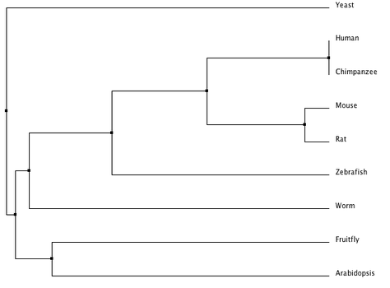
SOD1 phylogeny
✔
✔
Notes:
Zebrafish have been established as a useful model organism in ALS research. The quick generation time and many experimental tools available make it a desirable model to use.

Slide 17
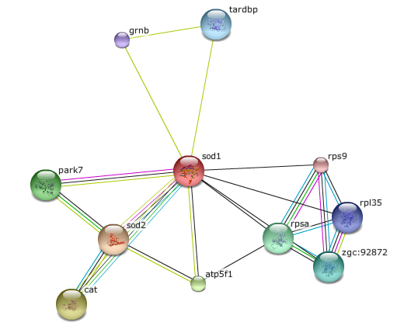
Zebrafish SOD1 interaction network
Notes:
Park7 in the zebrafish network. Another reason it could be a good model of the human disease.

Slide 18
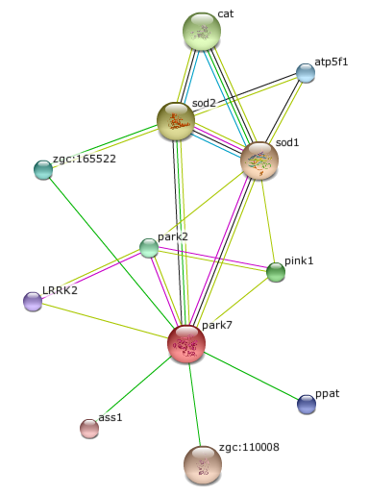
Zebrafish SOD1 and PARK7 interaction network
Notes:
SOD1 and Park7 network also shows UBQ containing protein. Another sign that they could have aggregates containing ubiquitin.

Slide 19
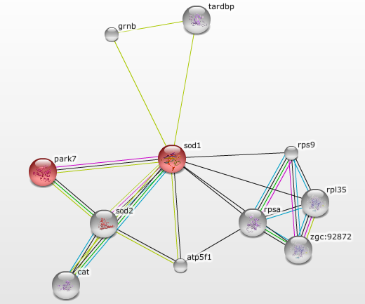
SOD1 and PARK7 in mitochondria
Notes:
Park7 and sod1 are both in mitochondria, along with 1 other protein atp5f1.

Slide 20
Gene Ontology: Biological Processes
Apoptosis
SOD1
Mitochondrial Respiration
Notes:
Mitochondrial localization links back to biological processes. Since respiration defects can lead to apoptosis, I wanted to look at respiration.

Slide 21
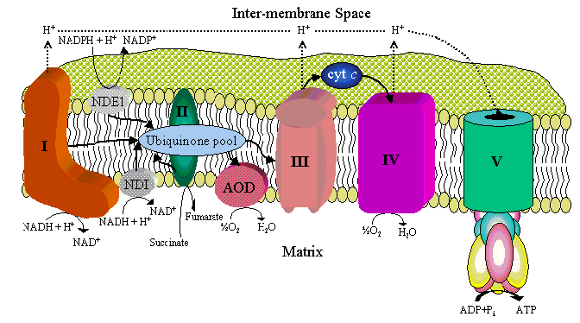
Mitochondrial respiration
http://pages.slu.edu/faculty/kennellj/images/respchain2.gif
Notes:
Biochem review: electron transport chain has 5 subunits that move electrons to create an proton gradient which leads to the production of ATP by atp synthase (complex 5).

Slide 22
Mitochondrial respiration
http://pages.slu.edu/faculty/kennellj/images/respchain2.gif
Notes:
Atp5f1 is a subunit of atp synthase. So zebrafish seem like a good model organism. But Zebrafish network only has one other mito protein. Is this connection representative? What about other model organisms?

Slide 23
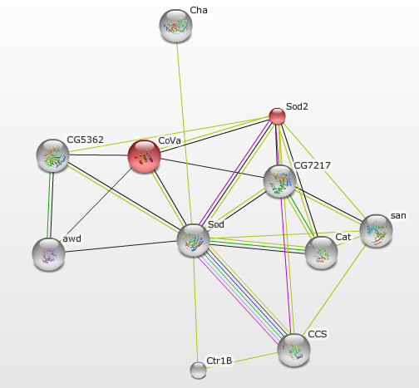
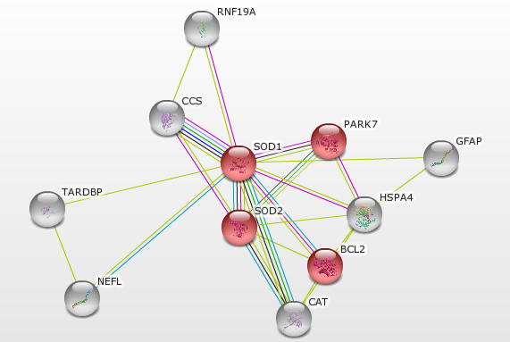
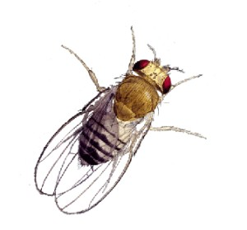
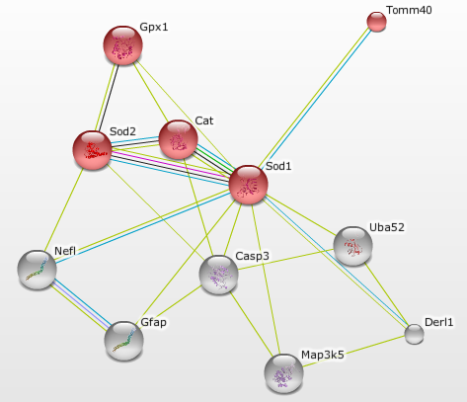
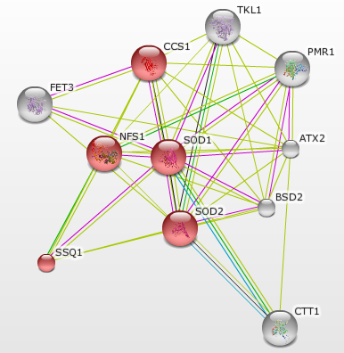
High incidence of mitochondrial proteins in interaction networks
Notes:
Each of human, mouse, fly and yeast networks is made up of about half mitochondrial proteins

Slide 24
Question: What else is in ALS aggregates?
Hypothesis: ALS aggregates will include SOD1, Ubiquitin, Neurofilaments, mitochondrial proteins.
Approach: Proteomic analysis of aggregates in SOD1 mutant zebrafish

Slide 25
Experimental Design
MudPIT on aggregates to identify components
G93R-SOD1 overexpression mutant
Culture motor neurons
Subcellular fractionation
Notes:
G93R known to have ALS-like phenotypes

Slide 26
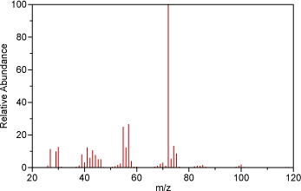
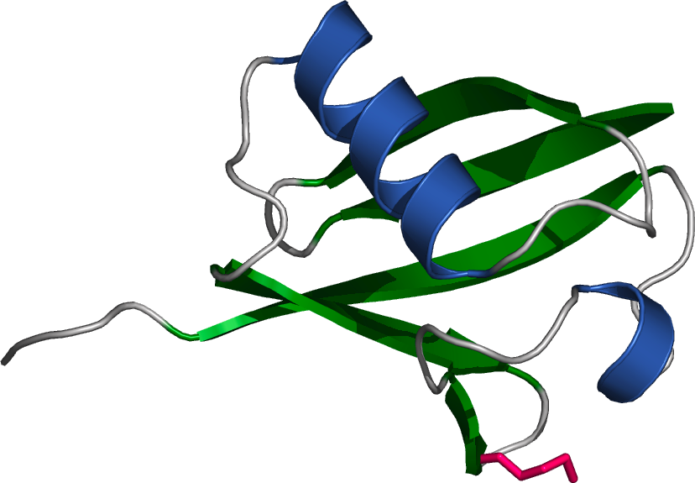
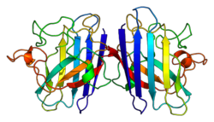
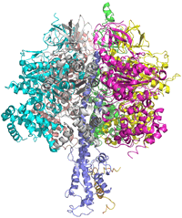
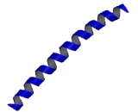
Hypothetical results
Notes:
Mass spec data gives us SOD1, Ubq, Neurofilaments, ATP synthase, mitochondrial proteins

Slide 27
SOD1 aggregates lead to mitochondrial defects
Notes:
These aggregates causing problems in mitochondria. If the aggregates are causing defects in some mitochondrial proteins and these defects are leading to ALS, one might expect that mutations in the mitochondrial proteins themselves could lead to ALS.

Slide 28
Hypothesis: Mutations in genes encoding mitochondrial proteins in aggregates cause ALS.

Slide 29
Genes known to cause ALS
ALS2
ANG
ATXN2
BCL11B
BCL6
C9orf72
CDH13
CDH22
CHMP2B
CNTN6
CRIM1
CRYM
DAO
DCTN1
DIAPH3
DOC2B
EWS
FEZF2
FIG4
GRB14
LUM
NEFH
NETO1
OMA1
OPTN
PCP4
RAMP3
SETX
SIGMAR1
SOX5
SPG11
SQSTM1
SYT9
TAF15
TARDBP
UBQLN2
VAPB
VCP
http://alsod.iop.kcl.ac.uk/misc/dataDownload.aspx#C1

Slide 30
Genes known to cause ALS
ALS2
ANG
ATXN2
BCL11B
BCL6
C9orf72
CDH13
CDH22
CHMP2B
CNTN6
CRIM1
CRYM
DAO
DCTN1
DIAPH3
DOC2B
EWS
FEZF2
FIG4
GRB14
LUM
NEFH
NETO1
OMA1
OPTN
PCP4
RAMP3
SETX
SIGMAR1
SOX5
SPG11
SQSTM1
SYT9
TAF15
TARDBP
UBQLN2
VAPB
VCP
Mitochondrial Metalloendopeptidase OMA1
Negative regulator of
mitochondrial fusion
http://alsod.iop.kcl.ac.uk/misc/dataDownload.aspx#C1

Slide 31
Zebrafish SOD1 and PARK7 interaction network
Notes:
Pink1 from the sod1 park7 network is a regulator of mitochrondrial fusion/fission.

Slide 32
Proposed model
mSOD1
Disturbance of mitochondrial respiration; apoptosis, etc.
Abnormal mitochondrial
dynamics
Notes:
Talk about weaknesses

Slide 33
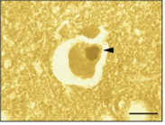
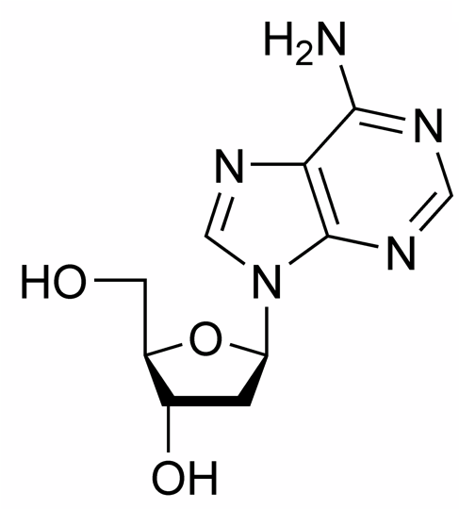
Future experiments
Further characterization of OMA1
Chemical genetics: mitochondrial proteins in fusion and fission
(Tateno et al. 2009)

Slide 34
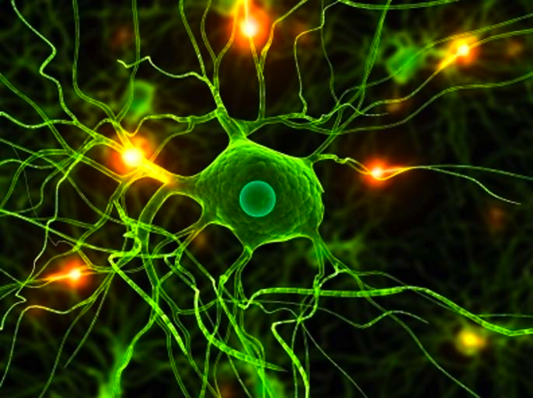
Questions?

